Slide 1



DIABETES PREDICTION
by
Shambhavi S

Slide 2
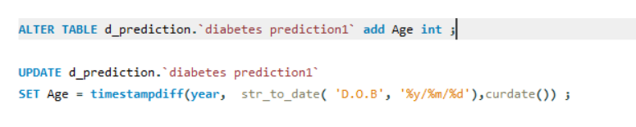
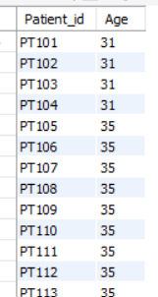
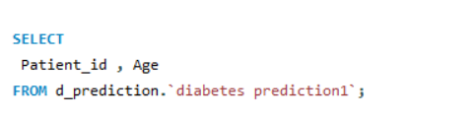
Retrieve the Patient_id and ages of all patients.

Slide 3
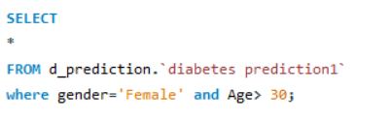
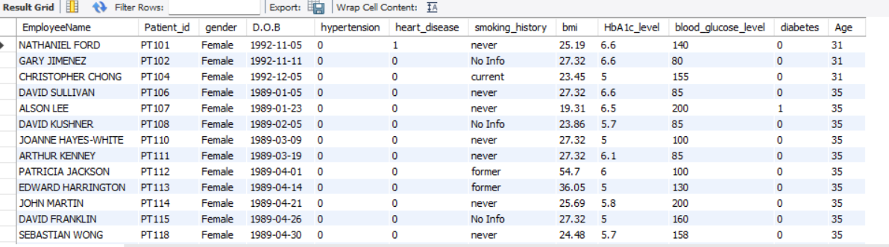
Select all female patients who are older than 30.

Slide 4
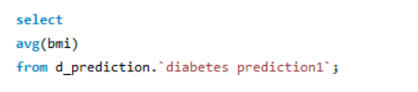
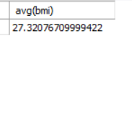
Calculate the average BMI of patients.

Slide 5
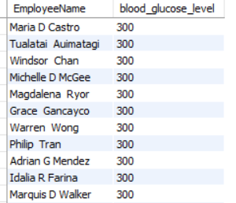
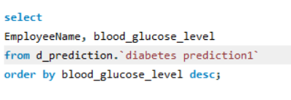
List patients in descending order of blood glucose levels.

Slide 6
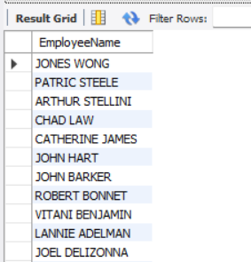
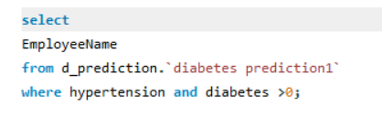
Find patients who have hypertension and diabetes.

Slide 7
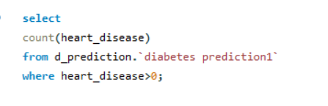
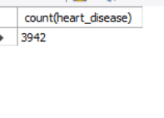
Determine the number of patients with heart disease.

Slide 8
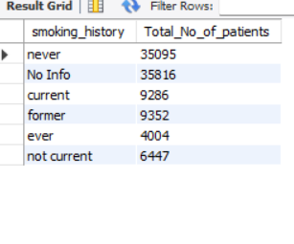
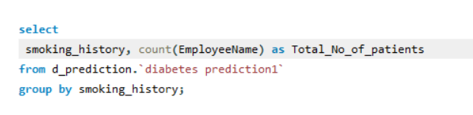
Group patients by smoking history and count how many smokers and non- smokers there are.

Slide 9
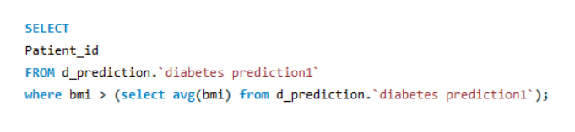
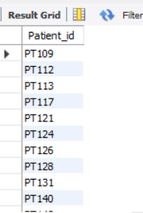
Retrieve the Patient_id of patients who have a BMI greater than the average BMI.

Slide 10
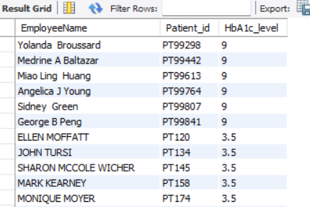
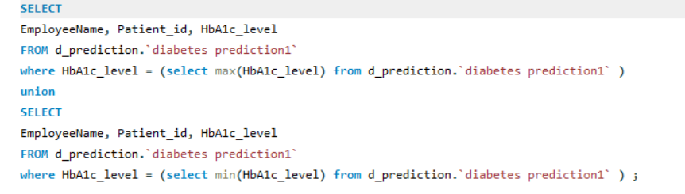
Find the patient with the highest HbA1c level and the patient with the lowest HbA1clevel.

Slide 11


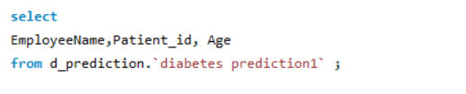
Calculate the age of patients in years (assuming the current date as of now).

Slide 12
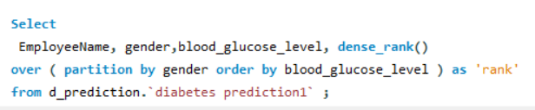
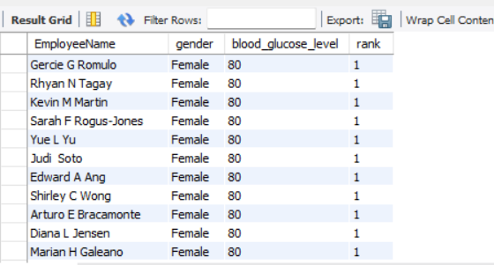
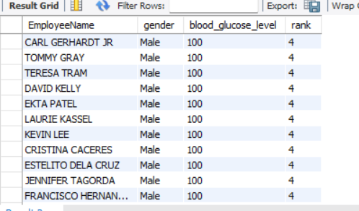
Rank patients by blood glucose level within each gender group.

Slide 13
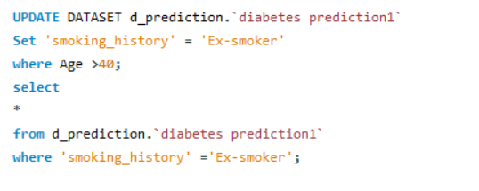
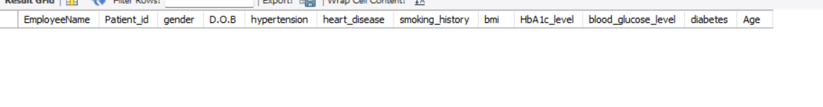
Update the smoking history of patients who are older than 40 to "Ex-smoker."
There are no Patients who are older than 40 in the dataset

Slide 14
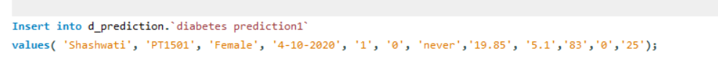
Insert a new patient into the database with sample data.

Slide 15
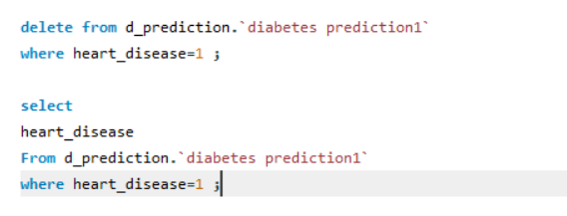
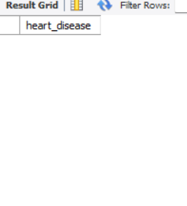
Delete all patients with heart disease from the database.

Slide 16
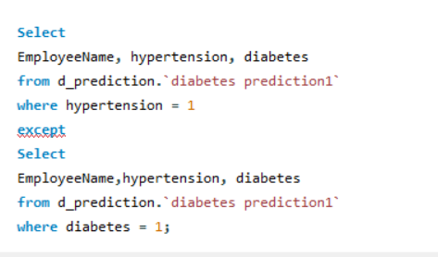
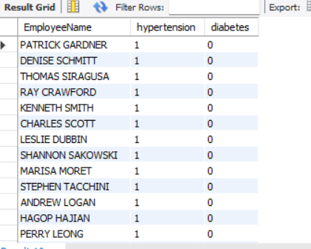
Find patients who have hypertension but not diabetes using the EXCEPT operator.

Slide 17
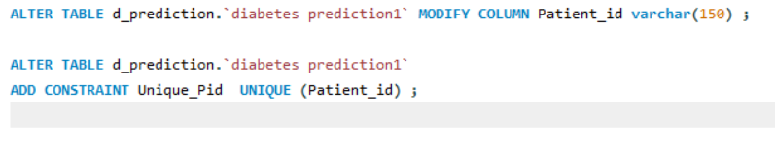
Define a unique constraint on the "patient_id" column to ensure its values are unique.

Slide 18
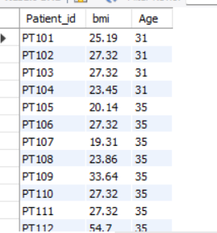
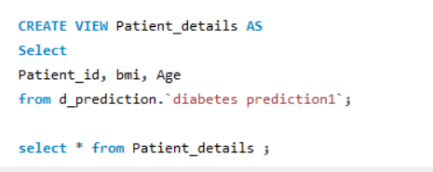
Create a view that displays the Patient_ids, ages, and BMI of patients.

Slide 19
Suggest improvements in the database schema to reduce data redundancy and improve data integrity.
Normalization techniques can be used to prevent redundancy in a database. Breaking down a larger table into smaller tables and establishing relationships between them, reduces redundancy and makes the data more reliable.
Ensure that data is consistent, not stored in multiple places within the database which may leading to inconsistency.
Make sure that the data in a table is accurate and unique to maintain data integrity.
Denormalization simplifies queries but increases data redundancy, hence avoid it.

Slide 20
Explain how you can optimize the performance of SQL queries on this dataset.
Limit the number of rows you need in a query. As the number of rows increases, the search speed decreases. Hence avoid select queries.
Minimize subqueries, this is because they can slow down the performance of the query when used in WHERE or HAVING clauses. Instead use JOIN clauses.
Monitor query performance by checking on the run-time of the queries. This improves efficiency and cost reduction.
Use stored procedures.

Slide 21

Thank You
This Photo by Unknown Author is licensed under CC BY-SA

